Slide 1

CHAITANYA INSTITUTE OF TECHNOLOGY AND SCIENCE Kishanpura, Hanamkonda. DEPARTMENT OF ELECTONICS AND COMMUNICATION ENGINEERING
PORTABLE DIGITAL CLOCK
Project Done By
B.Varsha (214931560L)
T.Thanmai (20493T1508)
B.Abhignareddy (20493T1537)
V.Niranjan (20493T1529)
Dr ANVESH THATIKONDA Dr.k. SEETHARAM
Project Guide Head of the department

Slide 2
CONTENTS
Abstract
Introduction
Literature survey
Components we use
Block diagram
Circuit diagram
Explanation of components
Advantages
Applications
Future scope
Conclusion
References

Slide 3
ABSTRACT
In this project, we design an Arduino based real time clock with date and temperature.
The design consists of all the features that a digital clock should consist.
An RTC displays clock and calendar with alltimekeeping functions. The battery, which is connected to the RTC is a separate one and is not related or connected to the maim power supply.

Slide 4
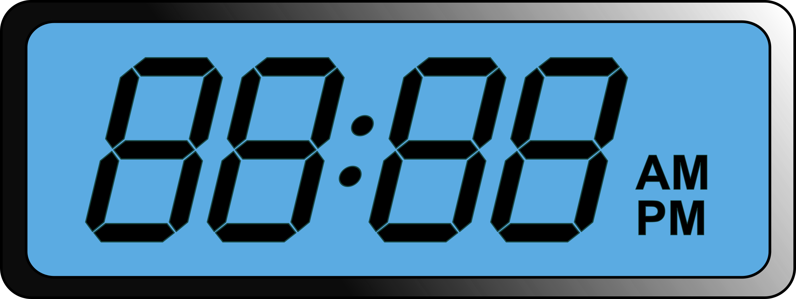
INTRODUCTION
At this time most peoples in the whole world use an automated digital clock in their everyday use.
In 21th century time being more than money, regarding this change our hobbies of checking our time every minute is dramatically increasing.
A digital clock is a type of clock that displays the time digitally
The first digital pocket watch was the invention of Austrian engineer Josef pallweber who created his “jump-hour” mechanism in 1883.
In 1970, the first digital wristwatch with LED display was mass-produced, called the pulsar.

Slide 5
LITERATURE SURVEY
In all walks of life, digitals system are making sophisticated approach to the mankind.
Of course the machines cannot be replaced by human beings in exact accuracy in some fields.
For a long time humans were using analog devices in our case analog clocks in their daily life.

Slide 6
COMPONENTS WE USE
Arduino NANO
RTC DS3231
8×32 Dot Matrix
Jumper wires
Bread Board

Slide 7
BLOCK DIAGRAM

Slide 8
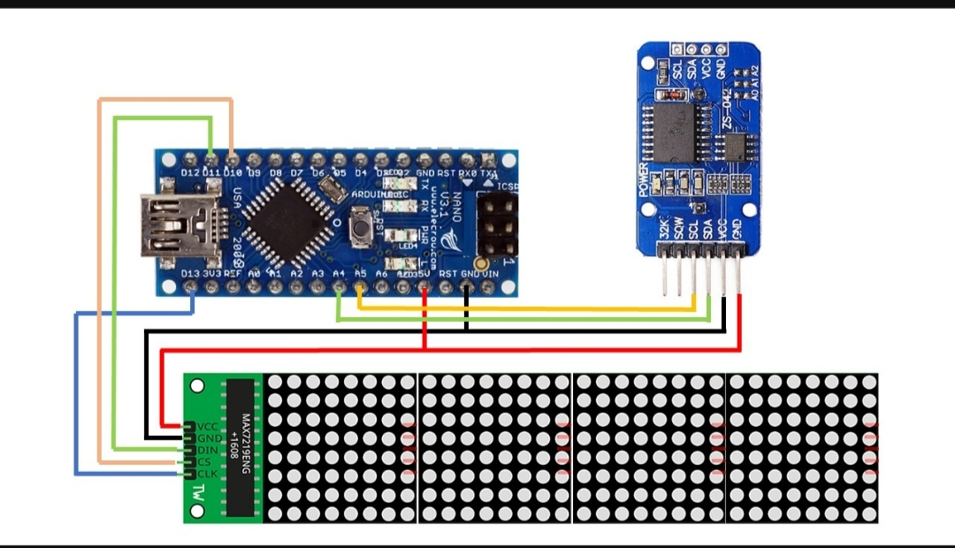
CIRCUIT DIAGRAM

Slide 9
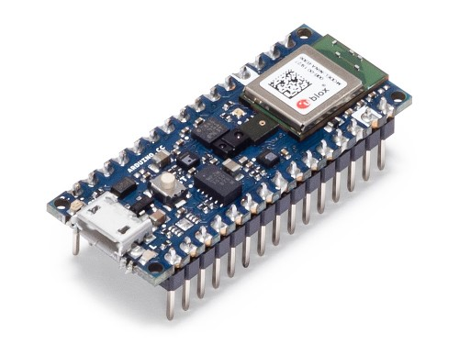
ARDUINO NANO
Arduino Nano is a small, complete, flexible and breadboard-friendly microcontroller board, based on A Tmega32p, developed by Arduino.cc in Italy in 2008 and contains 30 male I/O headers.
Arduino NANO pinout contains 14 digital pins,8 analogy pins, 2 Reset pins & 6 power pins.
It is programmed using Arduino IDE, which can be downloaded from Arduino Official site.

Slide 10
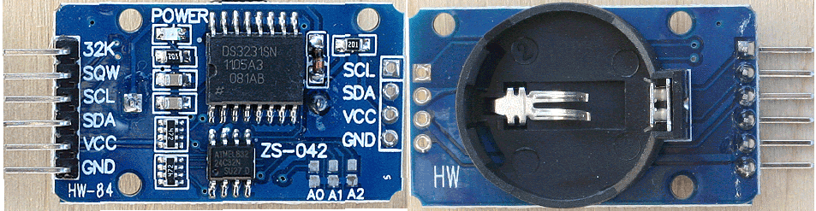
REAL TIME CLOCK
RTC is used to store Time and Date in the system even when the system is not in operation. This is the system used in many devices including laptop, mobile phones, tablet, digital cameras etc. RTC is inbuilt part of any electronics device. DS3231 is widely used RTC. When the power is restored, RTC displays the real time irrespective of the duration for which the power is off.

Slide 11
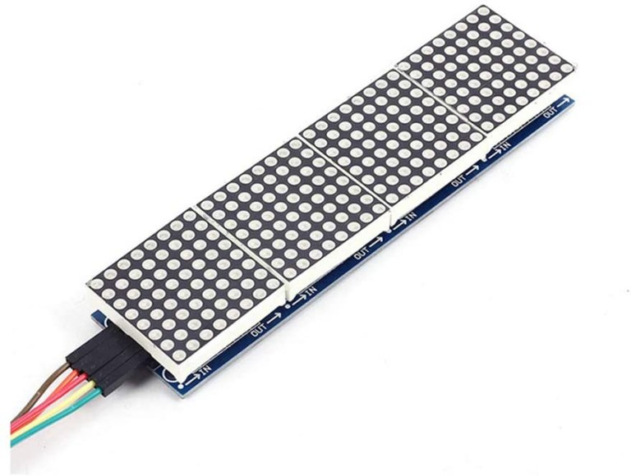
8×32 DOT MATRIX
A dot matrix is a 2-dimensional patterned array, used to represent characters, symbols and images. Most types of modern technology use dot matrices for display of information, including mobile phones, televisions, and printers.

Slide 12
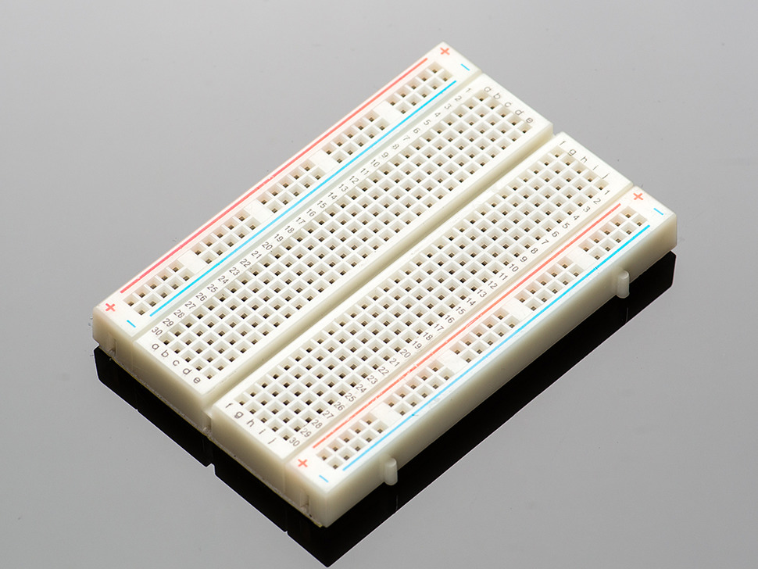
BREAD BOARD
A breadboard (sometimes called a plugblock) is used for building temporary circuits. It is useful to designers because it allows components to be removed and replaced easily. It is useful to the person who wants to build a circuit to demonstrate its action, then to reuse the components in another circuit.

Slide 13
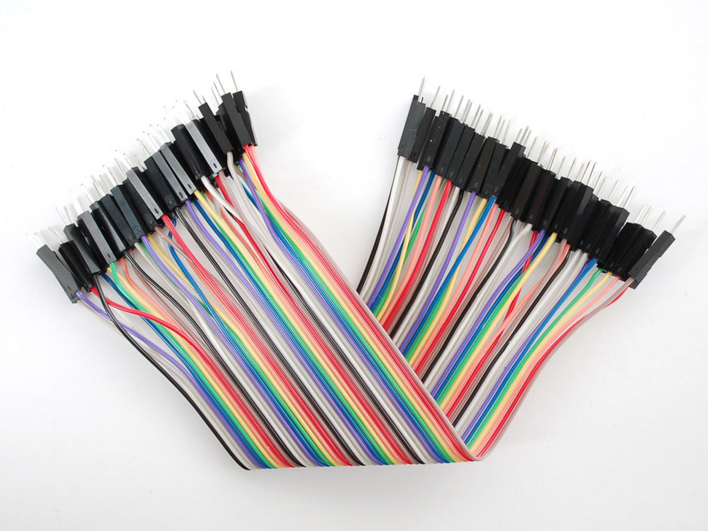
JUMPER WIRES
Jumper wires are simply wires that have connector pins at each end, allowing them to be used to connect two points to each other without soldering. Jumper wires are typically used with breadboards and other prototyping tools in order to make it easy to change a circuit as needed. Fairly simple. In fact, it doesn’t get much more basic than jumper wires.

Slide 14
ADVANTAGES
It is light and compact.
Less expensive.
Easy to understand time concept.
Give time more accurately than analog clock.
No Radiation.
Exact time resume- if there is any power failure, there will not be any time display on the clock. But as soon as the electric power resumes, the clock will show the right time automatically.

Slide 15
APPLICATIONS
Because digital clocks can be very small and inexpensive devices that enhance the popularity of product designs, they are often incorporated into all kinds of devices such as cars, radios, televisions, microwave ovens, standard ovens, computers and cell phones. Sometimes their usefulness is disputed: a common complaint is that when time has to be set to Daylight Saving Time, many household clocks have to be readjusted. The incorporation of automatic synchronization by a radio time signal is reducing this problem (see Radio clocks). Smart digital clocks, in addition to displaying time, scroll additional information such as weather and notifications.

Slide 16
FUTURE SCOPE
Set Time setting, off and on system.
Set Date System.
Set Alarm system.

Slide 17
CONCLUSION
Now-a-days different pattern of digital clocks are available in the market but most of them are of very price and low quality.
Most of those cannot provide the time accurately for longer period as those are designed with IC’s like 555 timer.
But our designed multipurpose digital clock is accurate because of its Real Time Clock module that keeps time update.
We have completed this project successfully and have successfully made a 12 hour digital clock with an a A.M/P.M display.

Slide 18
REFERENCES
https://github.com/leonardosposina/ar..
https://github.com/manjuhm

Slide 19
THANK YOU

